Slide 1




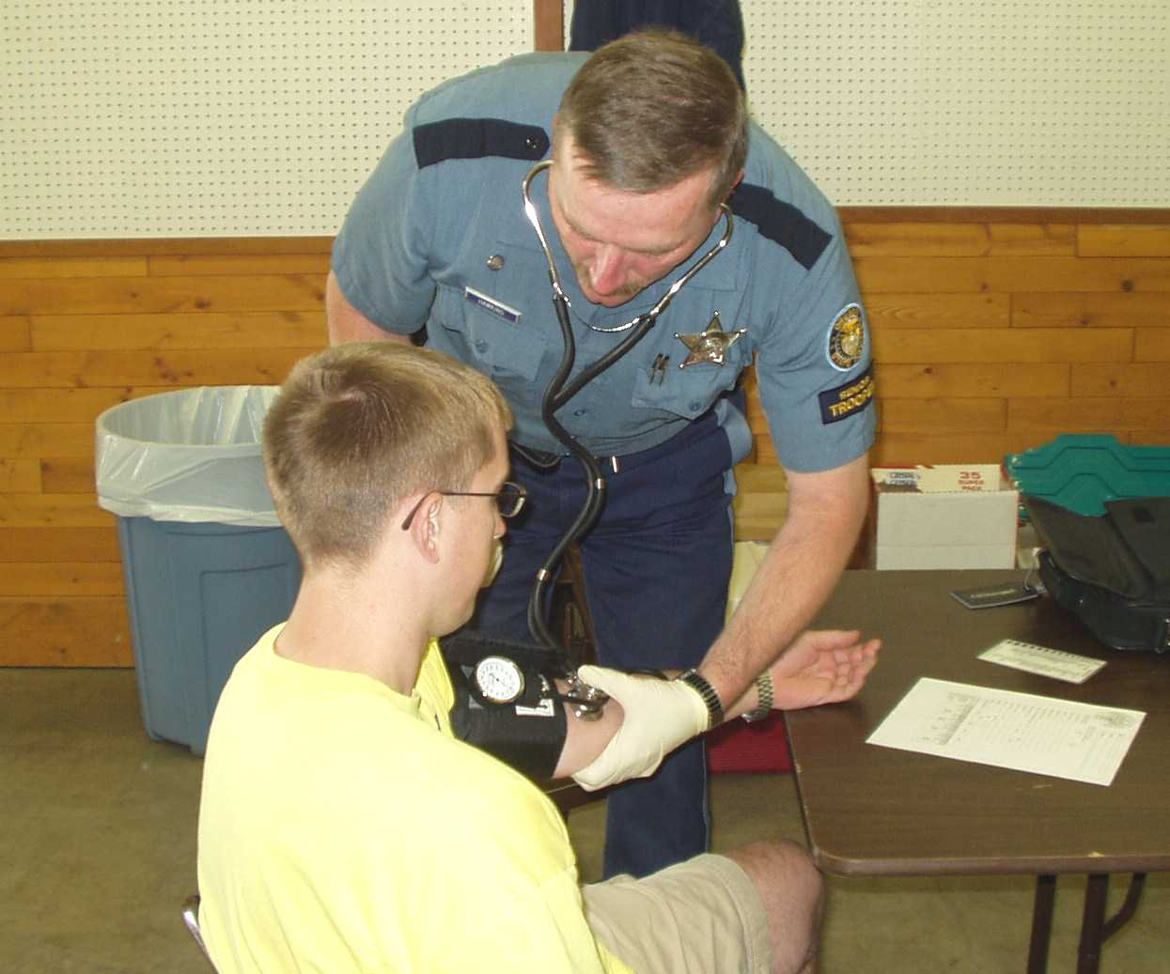
Session 6
Examinations of Vital Signs

Slide 2
Learning Objectives
List vital signs utilized in the DRE drug influence evaluation
Define basic terms relevant to pulse rate and blood pressure measurements
Measure pulse rate and blood pressure
Relate results of vital sign examinations to various categories of drugs

Slide 3
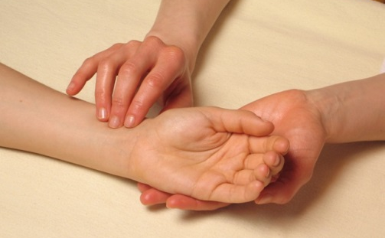
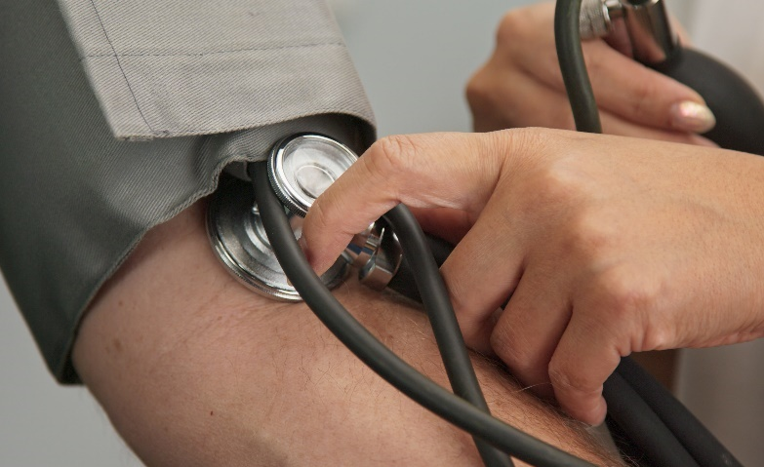
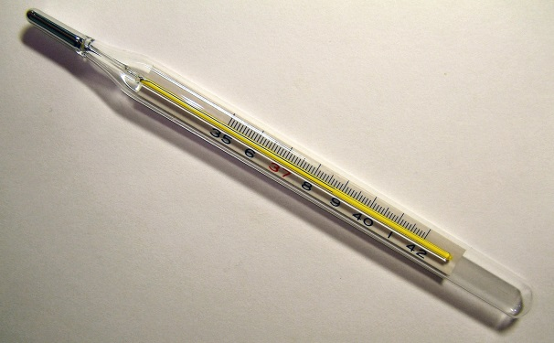
Vital Signs
Pulse Rate
Blood Pressure
Temperature

Slide 4
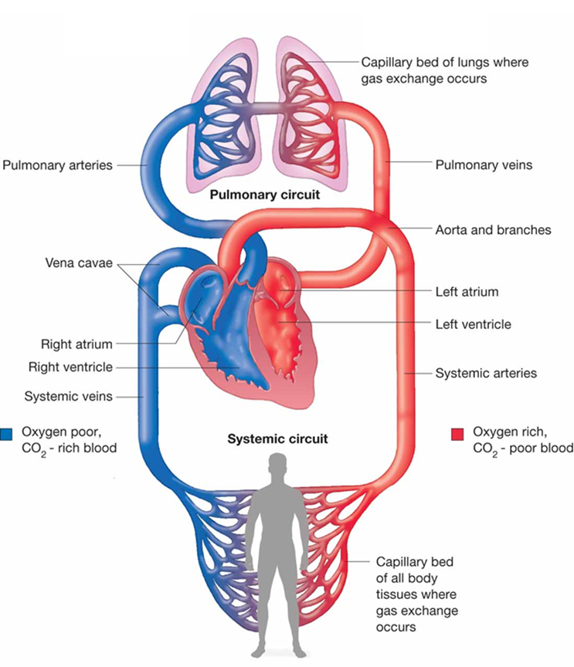
Basic Plan of the Circulatory System

Slide 5

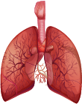
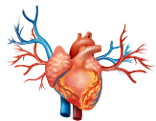

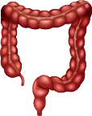

Circulatory System
Head and Arms
CO2
O2
Lungs
Systemic Circulation
Pulmonary
Circulation
Aorta
Pulmonary
Artery
Heart
Pulmonary
Vein
Food
Liver
Digestive Tract
Feces
(undigested food, shed intestinal cells and bacteria)
Kidneys
Urine
(waste products)
Trunk and Legs

Slide 6
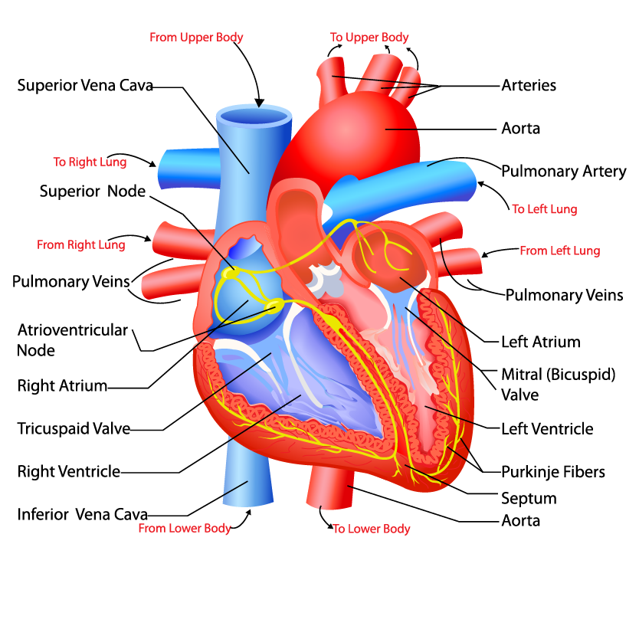
The Heart

Slide 7
Definitions Concerning “Pulse”
Pulse – Rhythmic dilation and relaxation of an artery that results from the beating of the heart
Pulse Rate – Number of pulsations in an artery per minute
Artery – A strong, elastic blood vessel that carries blood from heart to body tissues
Vein – A blood vessel that carries blood back to heart from body tissues

Slide 8
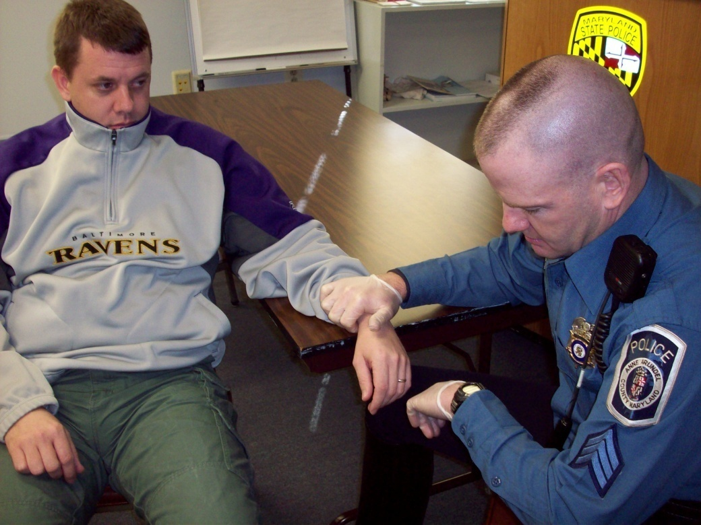
Radial Artery
Radial Artery
Pulse Point

Slide 9
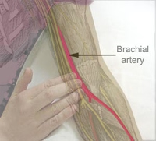
Brachial Artery

Slide 10
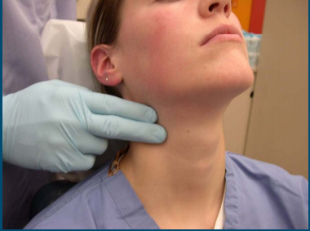
Carotid Artery
Carotid Artery
Pulse Point

Slide 11
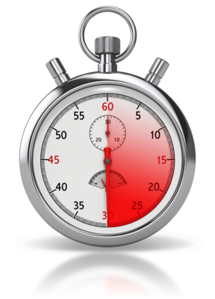



Proper Procedures of Measuring Pulse
X

Slide 12

Pulse Hands-On Practice

Slide 13
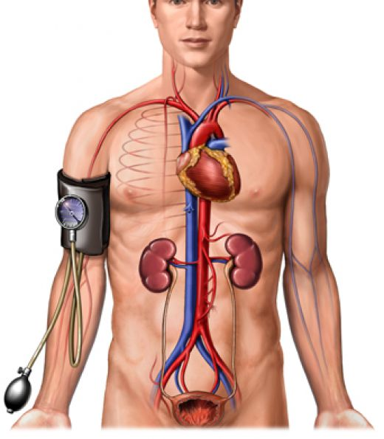
Blood Pressure
Systolic
Diastolic

Slide 14
Blood Pressure Definitions
Blood Pressure – Force that circulating blood exerts on walls of arteries
Systolic Pressure – Maximum blood pressure, reached as heart contracts
Diastolic Pressure – Minimum pressure, reached when heart is fully expanded

Slide 15
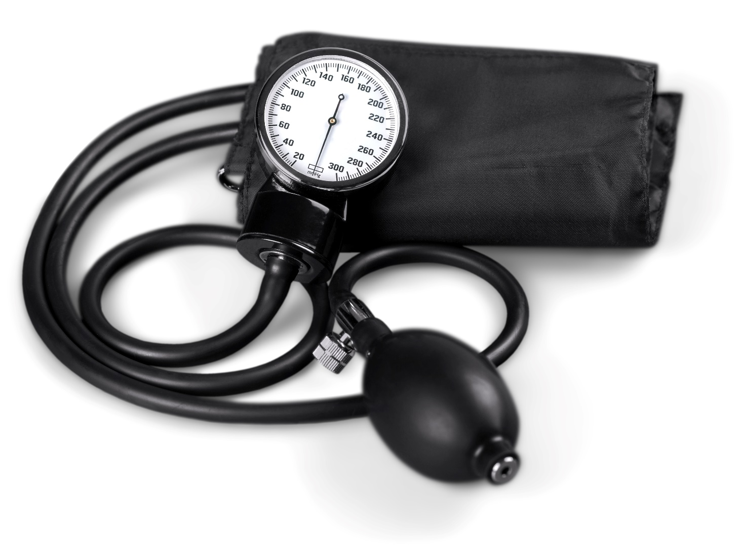
Sphygmomanometer

Slide 16

Sphygmomanometer
MANOMETER
(Pressure Gauge)
COMPRESSION
CUFF
TUBES
PRESSURE
CONTROL
VALVE
PRESSURE
BULB

Slide 17
Sphygmomanometer Demonstration

Slide 18
Measuring Blood Pressure
Apply enough air pressure to cut off flow of blood through artery
Slowly release air, about 2 mmHg per second, until blood just begins to spurt through artery: systolic pressure
Continue to release air until blood flows continuously: diastolic pressure

Slide 19
Overview of Procedures for Measuring Blood Pressure

Slide 20

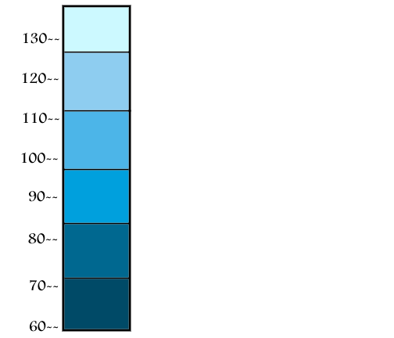
Korotkoff Sounds
Click to play a video of Korotkoff sounds
Phase 1 begins Systolic
Clear, tapping sounds
Phase 2 begins
Sounds change to murmur,
take on a “swishing” quality
Phase 3 begins
Sounds develop a loud, knocking quality
Phase 4 begins Sounds
Become muffled, faint “swishing” quality
Phase 5 begins Diastolic
The sounds cease

Slide 21
Blood Pressure Measurement
Position cuff on bicep so tubes extend down middle of arm
Wrap cuff snugly around bicep
Clip manometer to subject’s sleeve or in location to easily see gauge
Twist pressure control valve all the way to right

Slide 22
Blood Pressure Measurement
Put stethoscope earpieces in your ears
Apply stethoscope to brachial artery pulse point
Rapidly inflate bladder to level high enough to squeeze artery shut (Normally 180)

Slide 23
Blood Pressure Measurement
Twist pressure control valve slightly to left (pressure should drop at 2 mmHg per second)
Keep eyes on gauge and listen for Korotkoff sounds

Slide 24
Blood Pressure Values
Systolic: 120-140 mm/Hg
Diastolic: 70-90 mm/Hg
Some people can have significantly different blood pressures

Slide 25
Proper Procedures of Blood Pressure Measurement

Slide 26
Participant’s Initial Practice at Measuring Blood Pressure

Slide 27
Measuring Body Temperature
Oral thermometer recommended
Always use protective disposable mouthpiece
Position thermometer under subject’s tongue
Have subject refrain from talking when measuring temperature
Refrain from letting subject drink hot or cold fluids immediately prior to measuring temperature

Slide 28
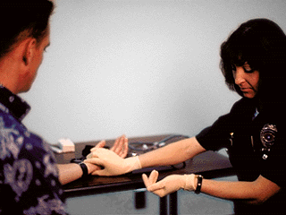
Measuring Pulse Rate

Slide 29
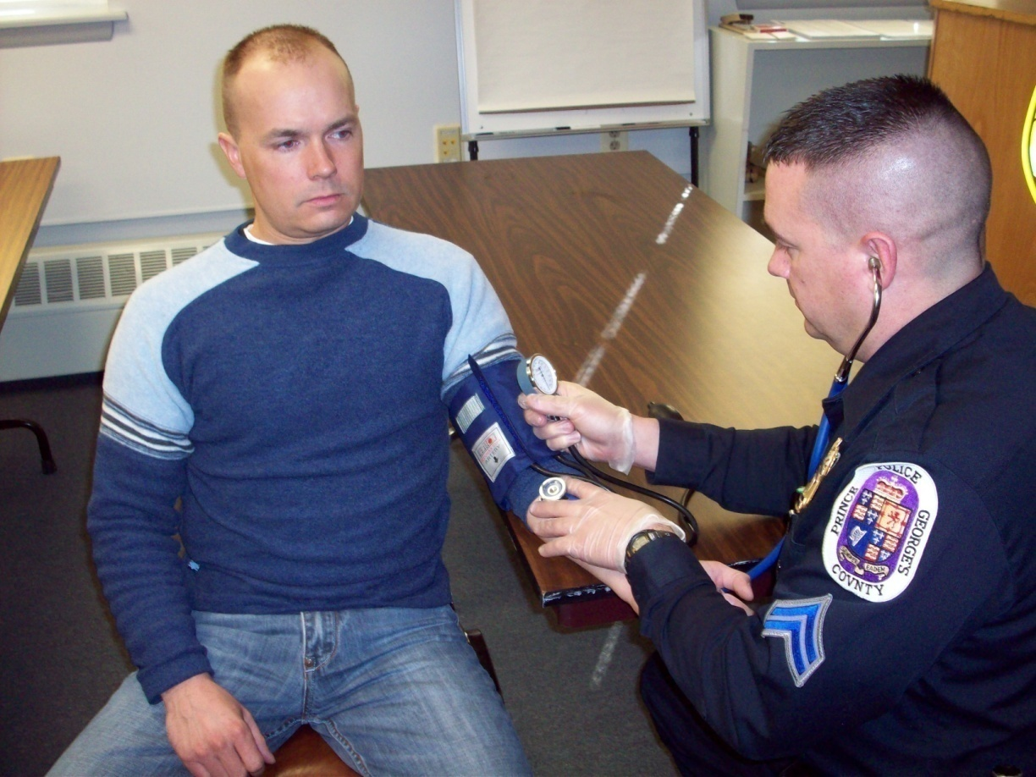
Measuring Blood Pressure

Slide 30
DRE Ranges of Vital Signs
Pulse Rate:
60 to 90 beats per minute
Blood Pressure:
Systolic – 120 to 140 mmHg
Diastolic – 70 to 90 mmHg
Body Temperature:
98.6 degrees Fahrenheit +/- one degree

Slide 31
Drug Categories and Vital Signs
All seven categories of drugs ordinarily will affect pulse rate and blood pressure
Some categories usually will lower pulse and blood pressure

Slide 32
Drug Categories and Vital Signs
Which drug categories affect temperature?

Slide 33
Drug Categories and Vital Signs
Which drug categories affect muscle tone?

Slide 34
Questions?

